Slide 1



SKKU Biostats and Big data
CHOONG-WAN WOO | COCOAN lab | http://cocoanlab.github.io

Slide 2
GBME Probability and Statistics
Lecture 07
Lecture 07
Regression wisdom, re-expressing data
CHOONG-WAN WOO | COCOAN lab | http://cocoanlab.github.io

Slide 3
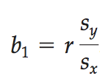
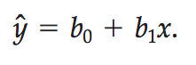
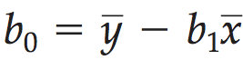
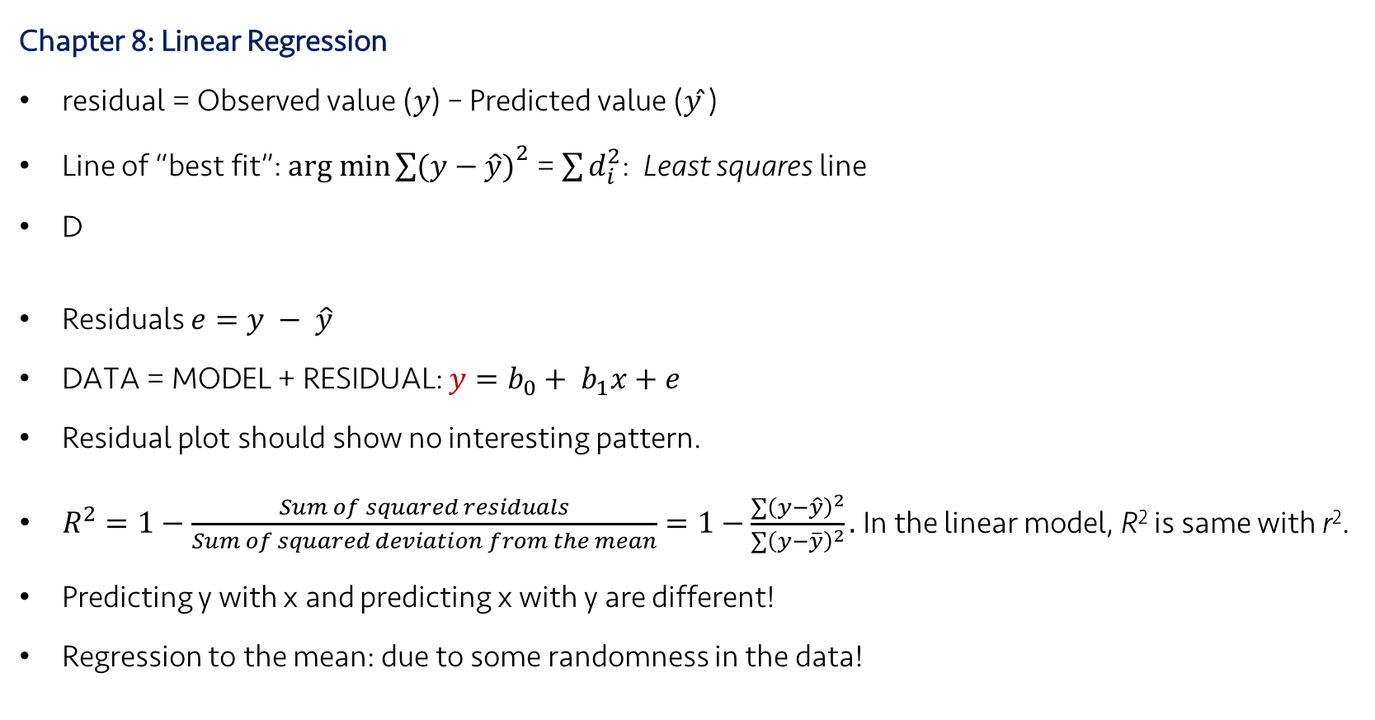
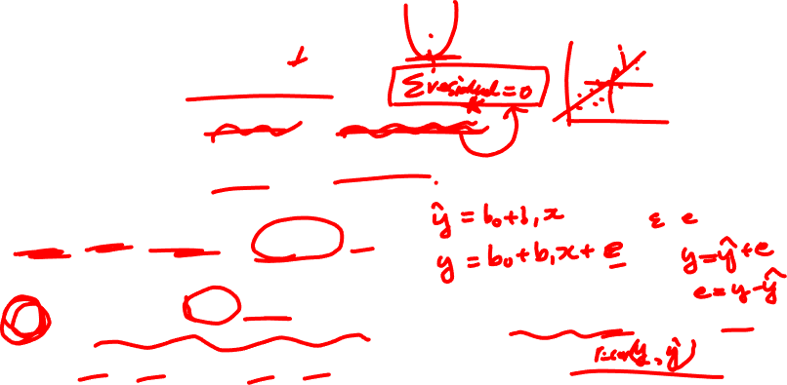
Lecture 07
Review: Key Points
Chapter 8: Linear Regression
residual = Observed value (𝑦) – Predicted value (𝑦 ̂)
Line of “best fit”: $arg min{\sum{(y−\hat{y})}}^{2}$ = $\sum{d_{i}^{2}}$: Least squares line
D
Residuals $e=y − \hat{y}$
DATA = MODEL + RESIDUAL: $y=b_{0}+ b_{1}x+e$
Residual plot should show no interesting pattern.
$R^{2}=1−\frac{Sum of squared residuals}{Sum of squared deviation from the mean}=1−\frac{\sum{{\left(y−\hat{y}\right)}^{2}}}{\sum{{\left(y−\overline{y}\right)}^{2}}}.$In the linear model, R² is same with r².
Predicting y with x and predicting x with y are different!
Regression to the mean: due to some randomness in the data!
Slope,
Intercept,
CHOONG-WAN WOO | COCOAN lab | http://cocoanlab.github.io

Slide 4
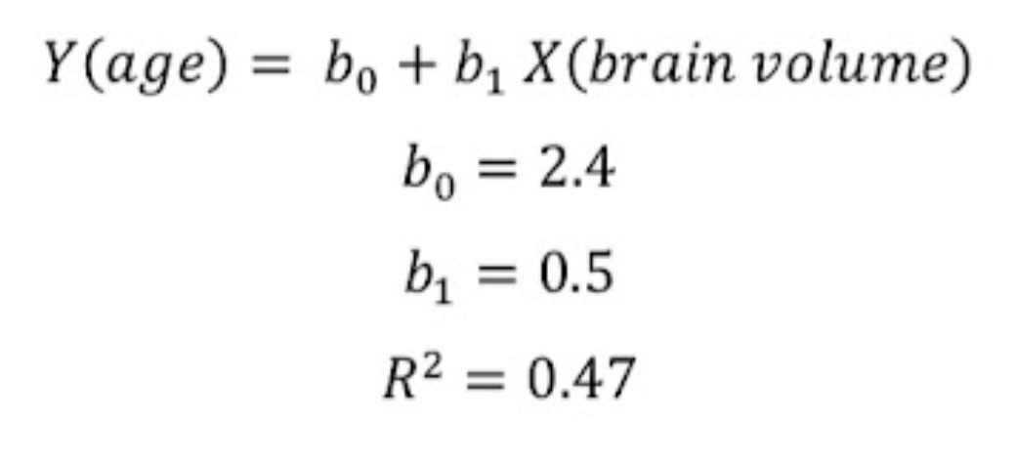
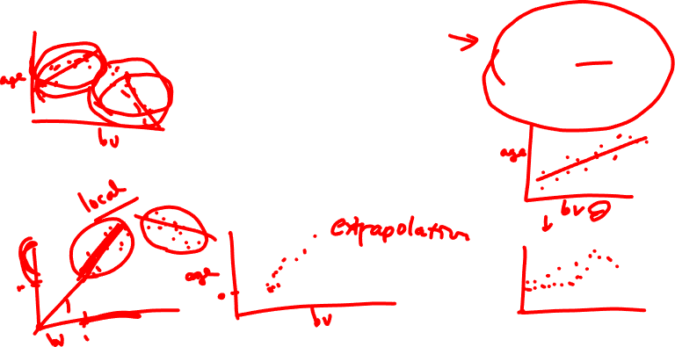
Quiz 07-1
https://forms.gle/JaRna2zq7SqJqWiT7
CHOONG-WAN WOO | COCOAN lab | http://cocoanlab.github.io

Slide 5
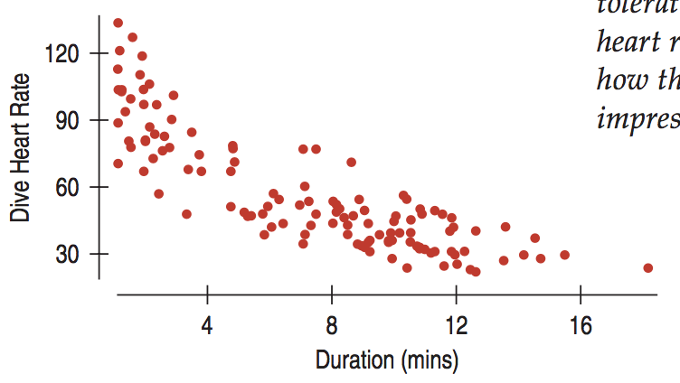
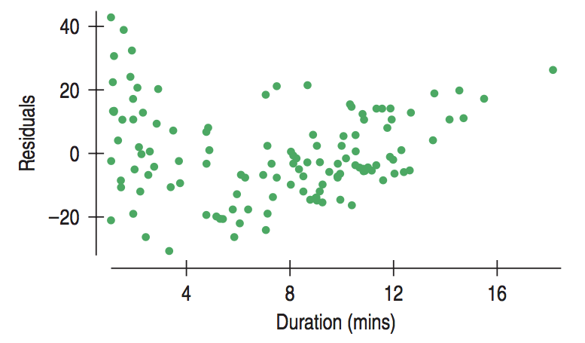

Lecture 07
Regression wisdom
“Bends” is often not apparent in the scatterplot of raw data. Residual plots will help!
CHOONG-WAN WOO | COCOAN lab | http://cocoanlab.github.io

Slide 6
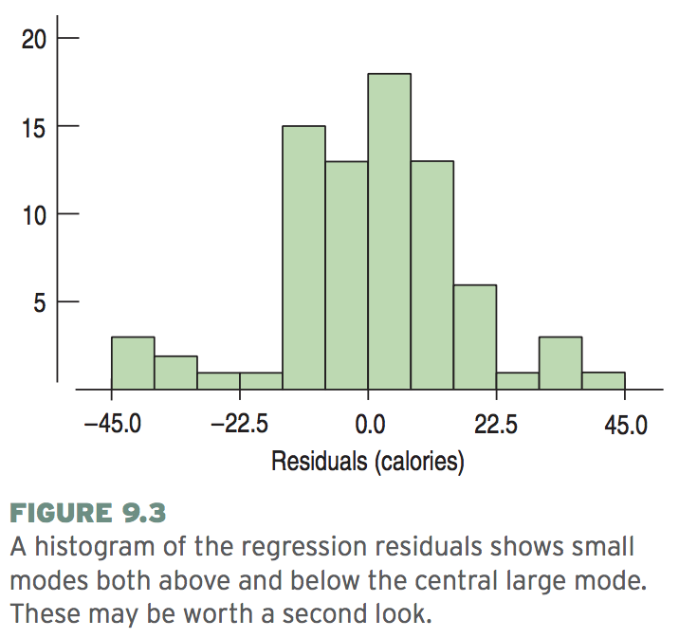
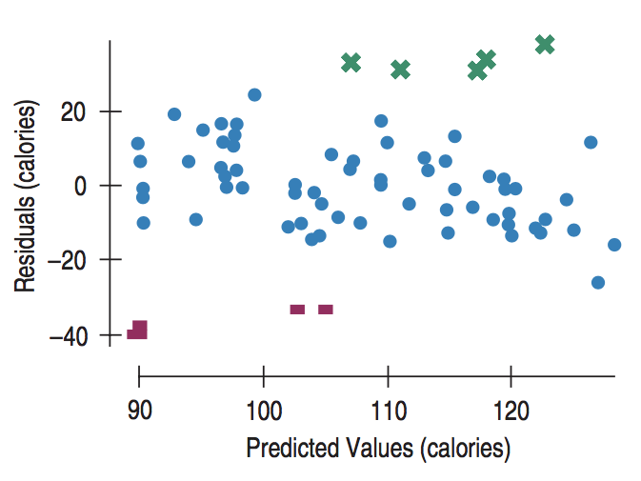
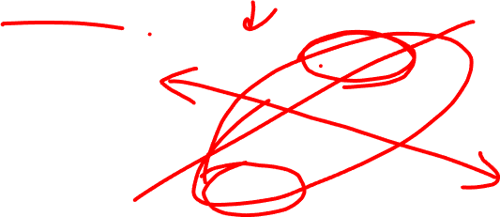
Lecture 07
Regression wisdom
“Bends” is often not apparent in the scatterplot of raw data. Residual plots will help!
Subgroups? Look at the histogram of the residuals
CHOONG-WAN WOO | COCOAN lab | http://cocoanlab.github.io

Slide 7
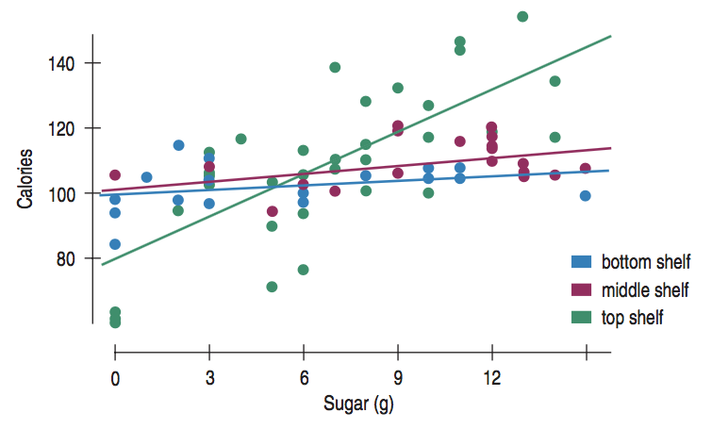
Lecture 07
Regression wisdom
“Bends” is often not apparent in the scatterplot of raw data. Residual plots will help!
Subgroups? Look at the histogram of the residuals
If you already know there are different groups, get the regression lines separately.
CHOONG-WAN WOO | COCOAN lab | http://cocoanlab.github.io

Slide 8
Lecture 07
Regression wisdom
“Bends” is often not apparent in the scatterplot of raw data. Residual plots will help!
Subgroups? Look at the histogram of the residuals
If you already know there are different groups, get the regression lines separately.
Extrapolation is not warranted (sampling bias, generalization error)
No causation!
Outlier!
CHOONG-WAN WOO | COCOAN lab | http://cocoanlab.github.io

Slide 9

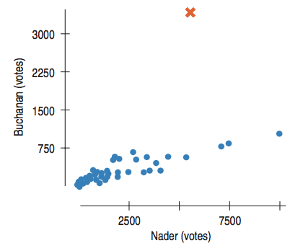
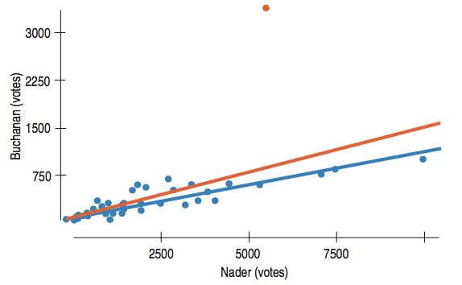
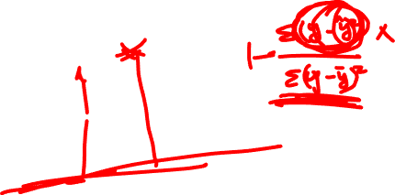
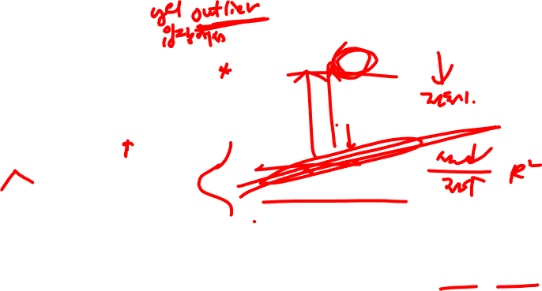
Lecture 07
Regression wisdom
Not so much change in line,
but the outlier drops R² a lot!
R² = .821 → R² = .428
CHOONG-WAN WOO | COCOAN lab | http://cocoanlab.github.io

Slide 10
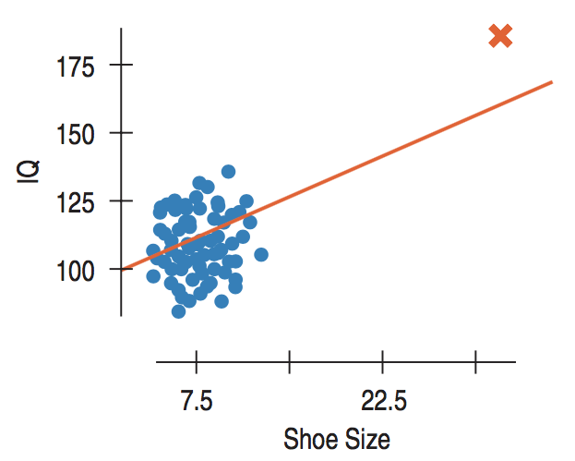
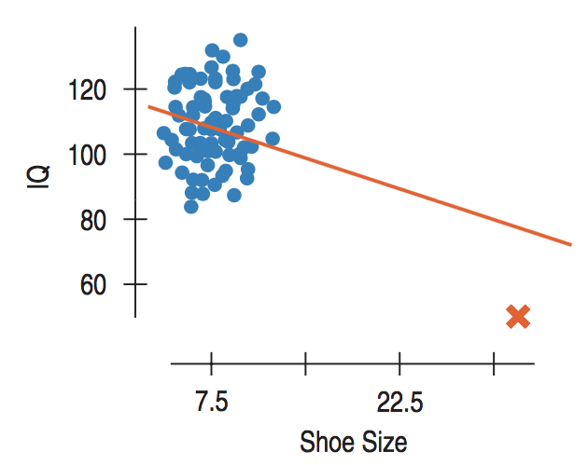
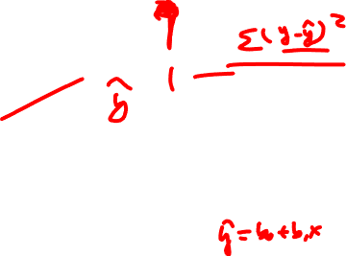
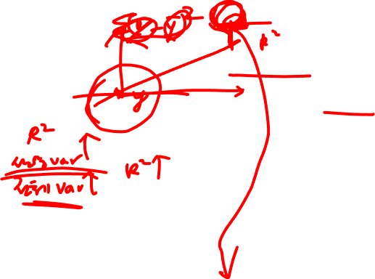
Lecture 07
Regression wisdom
High leverage
changes line a lot
and increases R² a lot
CHOONG-WAN WOO | COCOAN lab | http://cocoanlab.github.io

Slide 11
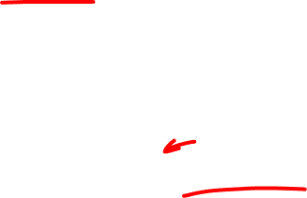
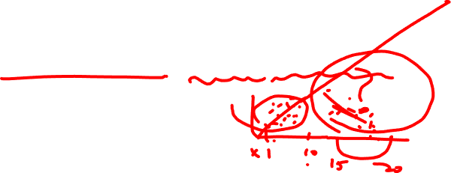
Lecture 07
Regression wisdom
“Bends” is often not apparent in the scatterplot of raw data. Residual plots will help!
Subgroups? Look at the histogram of the residuals
If you already know there are different groups, get the regression lines separately.
Extrapolation is not warranted (sampling bias, generalization error)
No causation!
Outlier!
Lurking variable (again)
Be cautious in working with summary statistics!
CHOONG-WAN WOO | COCOAN lab | http://cocoanlab.github.io

Slide 12
Quiz 07-2
https://forms.gle/ktMASYGyTFxdTvgw7
CHOONG-WAN WOO | COCOAN lab | http://cocoanlab.github.io

Slide 13
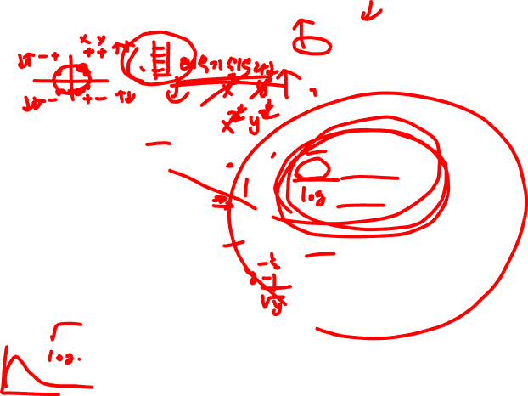
Lecture 07
Re-expressing Data: Tukey’s Ladder
x: down
y: up
x, y: up
x, y: down
x: up
y: down
CHOONG-WAN WOO | COCOAN lab | http://cocoanlab.github.io

Slide 14
Lecture 07
Re-expressing Data: Tukey’s Ladder
CHOONG-WAN WOO | COCOAN lab | http://cocoanlab.github.io

Slide 15
Quiz 07-3
https://forms.gle/3FunTwueHLcEmob19
CHOONG-WAN WOO | COCOAN lab | http://cocoanlab.github.io

Slide 16
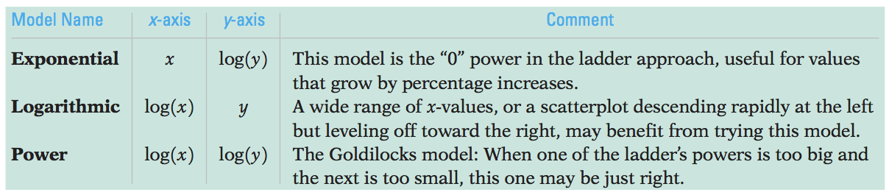
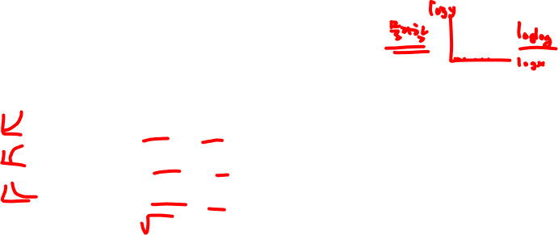
Lecture 07
Re-expressing Data: Logarithms
When none of the data values is zero or negative:
Watch out for negative data values
one possible cure for zeros and small negative values is to add a constant.
Watch for data far from 1
may not be much affected by re-expression
consider subtracting a constant to bring them back near 1 (e.g., years, 2000 -> 1)
CHOONG-WAN WOO | COCOAN lab | http://cocoanlab.github.io

Slide 17
Lecture 07
Key Points
Chapter 9 and 10: Regression wisdom, re-expressing data
Bends, subgroups, outliers
Cautious about extrapolation, causation, lurking variables, summary stats
Tukey’s ladder
CHOONG-WAN WOO | COCOAN lab | http://cocoanlab.github.io

